Slide 1
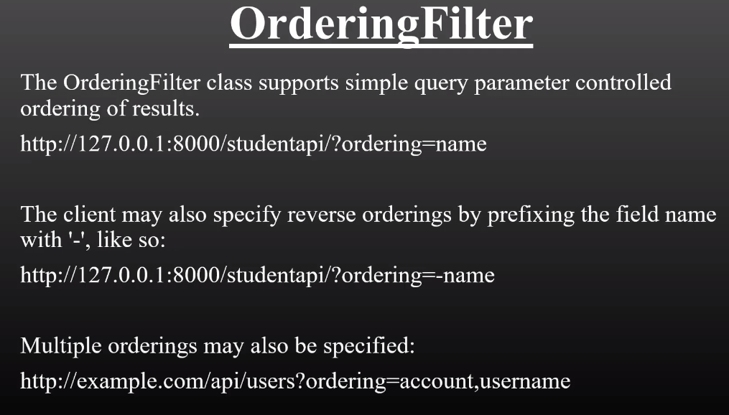
Ordering Filter

Slide 2
